Slide 1
UPPER SIXTH ARTS
GEOGRAPHY
Lesson 9
Population Growth and its Determinants
Notes:
Good morning, class, and welcome to our geography lesson. I am your geography teacher, Mr Kamdem. Today we are starting Lesson 9: Population Growth and its Determinants.

Slide 2
CLASS INFO
Class, Chapter and Duration
Class | Upper Sixth Arts
Chapter | Module 4: Understanding and managing population dynamics across the world in general and Cameroon in particular
Duration | 2 periods (2 × 50 minutes)
Notes:
This lesson is for Upper Sixth Arts. It belongs to Module 4: Understanding and managing population dynamics across the world in general and Cameroon in particular. We shall need 2 periods to cover it.

Slide 3
IDENTIFICATION
Lesson Identification
Topic | Population Change over Time (Population Growth)
Sub-topic | Population Growth
Lesson | Lesson 9: Population Growth and its Determinants
Notions / Concepts | Positive, negative and zero growth, population change system, natural increase, natural decrease, net migration, fertility, mortality, migration.
Syllabus focus | Meaning of population growth and the population change system; determinants of growth (fertility, mortality, migration) and their factors; spatial differences of growth on a world scale.
Competence | Learners are able to explain how births, deaths and migration change the population of an area such as Garoua.
Notes:
Our topic is Population Change over Time (Population Growth), and the sub-topic is Population Growth. The key notions we shall use today are: positive, negative and zero growth, population change system, natural increase, natural decrease, net migration, fertility, mortality, migration. At the end, you should be able to do this: learners are able to explain how births, deaths and migration change the population of an area such as Garoua.

Slide 4

HOMEWORK CORRECTION
Correction of the Homework
Question (Lesson 8: Historical Evolution of World Population):
Write the formula of population change.
Notes:
Before we start the new lesson, let us correct the homework I gave you at the end of Lesson 8: Historical Evolution of World Population. The question was: Write the formula of population change. Take out your exercise books.

Slide 5
HOMEWORK CORRECTION
Correction: Possible Answer
Population change = (births − deaths) + (immigrants − emigrants).
Notes:
Here is a good answer. Population change = (births − deaths) + (immigrants − emigrants). Compare it with your own answer and correct your work in red.

Slide 6
LESSON PLAN
Lesson Plan
Correction of the homework
Objectives and recall
Real-life situation and action to take
Learning activities
Board summary
Evaluation, remediation and homework
Notes:
Here is the plan of our lesson today. First, we shall correct the homework. Then we shall look at the objectives and recall what you already know. After that, we shall study a situation from real life and the action to take, and do the learning activities. Finally, we shall copy the board summary, do the evaluation and the remediation, and I will give you the homework.

Slide 7
OBJECTIVES
Objectives
By the end of this lesson, you should be able to:
Define positive, negative and zero growth.
Explain the population change system and its formula.
Notes:
Take your time to copy this part; we will continue together.

Slide 8
OBJECTIVES
Objectives (continued)
Explain the factors of fertility and mortality.
Explain the role of migration.
Compare growth in LEDCs and MEDCs.
Notes:
By the end of this lesson, you should be able to do five things. Number 1: define positive, negative and zero growth. Number 2: explain the population change system and its formula. Number 3: explain the factors of fertility and mortality. Number 4: explain the role of migration. Number 5: compare growth in LEDCs and MEDCs.

Slide 9
PREVIOUS KNOWLEDGE
Previous Knowledge
The world reached 8 billion in 2022.
Death rates fell with better medicine.
People move from villages to towns.
Notes:
Let us first remember what you already know. The world reached 8 billion in 2022. Death rates fell with better medicine. People move from villages to towns. Keep this in mind, because we shall build on it today.

Slide 10
REAL-LIFE SITUATION
Situation in Real Life
Amina lives in Djamboutou.
Her grandmother remembers when this quarter was farmland and bush, while most of Garoua was around the old town.
Today new houses are built every month, the roads are full of moto-taxis and Amina's classes are more crowded every year.
Notes:
Take your time to copy this part; we will continue together.

Slide 11
REAL-LIFE SITUATION
Situation in Real Life (continued)
Her grandmother had nine brothers and sisters, her mother five, and Amina only three.
Amina asks: "Where do all the new people of Garoua come from, and why are families becoming smaller?"
Notes:
Listen carefully to this situation from real life. Amina lives in Djamboutou. Her grandmother remembers when this quarter was farmland and bush, while most of Garoua was around the old town. Today new houses are built every month, the roads are full of moto-taxis and Amina's classes are more crowded every year. Her grandmother had nine brothers and sisters, her mother five, and Amina only three. Amina asks: "Where do all the new people of Garoua come from, and why are families becoming smaller?" Think about it, because I am going to ask you some questions.

Slide 12
REAL-LIFE SITUATION
Situation: Question 1
What is the problem in the situation?
Notes:
Question 1: What is the problem in the situation? Think for a moment, then raise your hand to answer.

Slide 13
REAL-LIFE SITUATION
Answer
Amina does not understand how the population of Garoua grows and what determines its growth.
Notes:
Good. Amina does not understand how the population of Garoua grows and what determines its growth.

Slide 14
REAL-LIFE SITUATION
Situation: Question 2
Is the population of Garoua increasing or decreasing?
Notes:
Question 2: Is the population of Garoua increasing or decreasing? Think for a moment, then raise your hand to answer.

Slide 15
REAL-LIFE SITUATION
Answer
It is increasing: this is positive growth.
Notes:
Good. It is increasing: this is positive growth.

Slide 16
REAL-LIFE SITUATION
Situation: Question 3
Where do the new people come from?
Notes:
Question 3: Where do the new people come from? Think for a moment, then raise your hand to answer.

Slide 17
REAL-LIFE SITUATION
Possible Answer
From births exceeding deaths and from people moving into Garoua.
Notes:
Good. From births exceeding deaths and from people moving into Garoua.

Slide 18
ACTION TO TAKE
Action to Take
Use the formula of population change to explain the growth of your town.
Notes:
From this situation, the action we are working towards in this lesson is the following: use the formula of population change to explain the growth of your town.

Slide 19
JUSTIFICATION
Justification of the Lesson
This lesson helps us to understand the causes of population change, which planners must know to prepare schools, jobs and housing.
Notes:
Why is this lesson important for you? This lesson helps us to understand the causes of population change, which planners must know to prepare schools, jobs and housing.

Slide 20
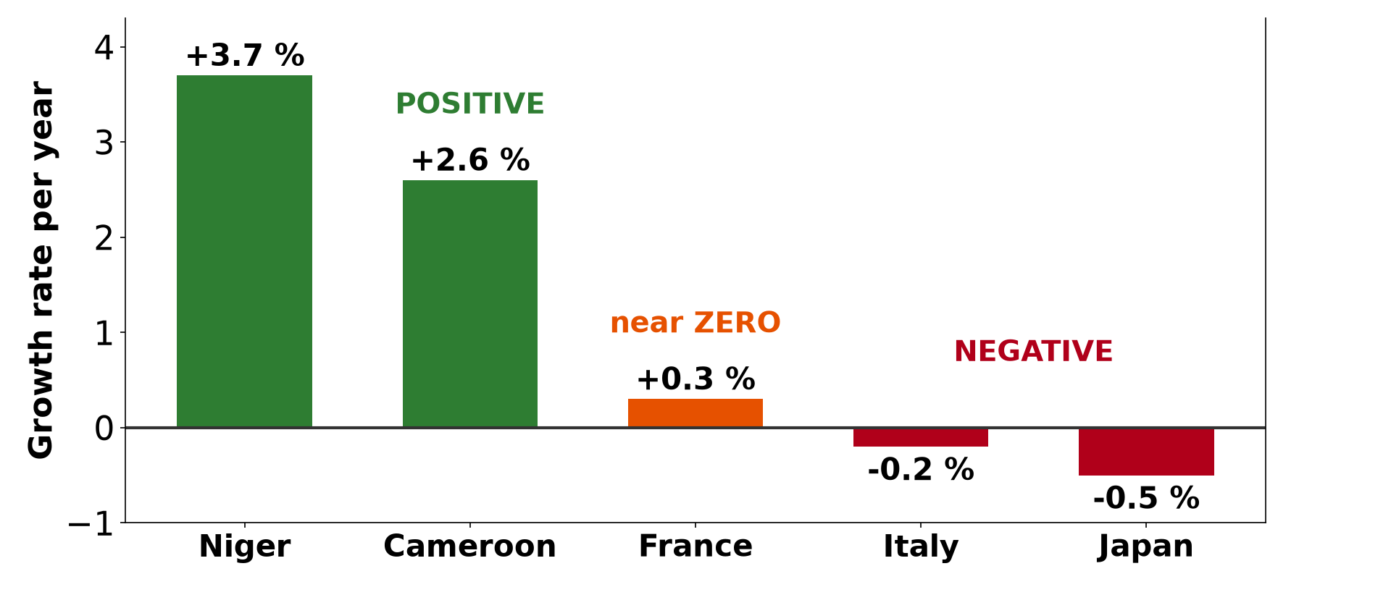
1. TYPES OF GROWTH
Activity 1
Positive, zero and negative growth.
Notes:
Activity 1. Look carefully at this diagram: positive, zero and negative growth. Observe every detail before I ask the question.

Slide 21
1. TYPES OF GROWTH
Activity 1: Question
Which country on the graph has negative growth?
Notes:
Here is the question for Activity 1: Which country on the graph has negative growth? Take one minute to think and write your answer in your rough notebook.

Slide 22
1. TYPES OF GROWTH
Activity 1: Answer
Italy or Japan.
Notes:
Let us check the answer together. Italy or Japan.

Slide 23
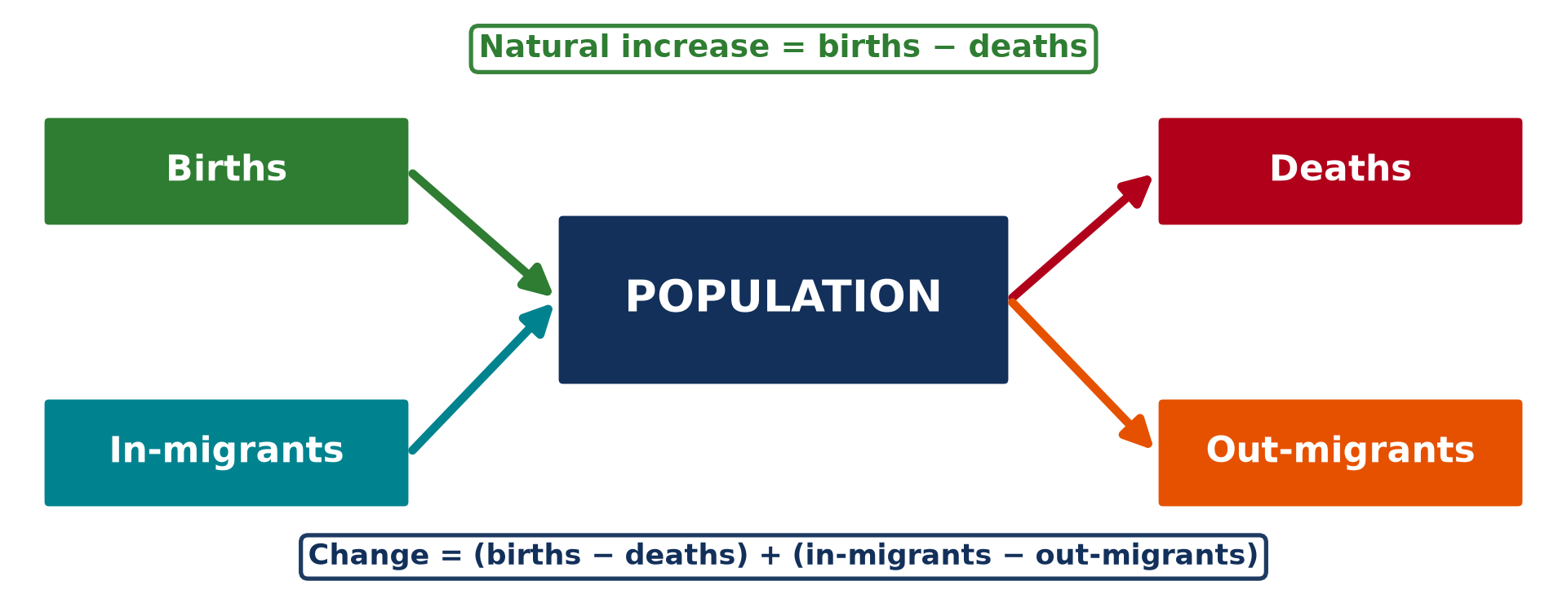
1. CHANGE SYSTEM
Activity 2
The population change system.
Notes:
Activity 2. Look carefully at this diagram: the population change system. Observe every detail before I ask the question.

Slide 24
1. CHANGE SYSTEM
Activity 2: Question
What are the two components of population change?
Notes:
Here is the question for Activity 2: What are the two components of population change? Take one minute to think and write your answer in your rough notebook.

Slide 25
1. CHANGE SYSTEM
Activity 2: Answer
Natural change (births − deaths) and net migration (immigrants − emigrants).
Notes:
Let us check the answer together. Natural change (births − deaths) and net migration (immigrants − emigrants).

Slide 26
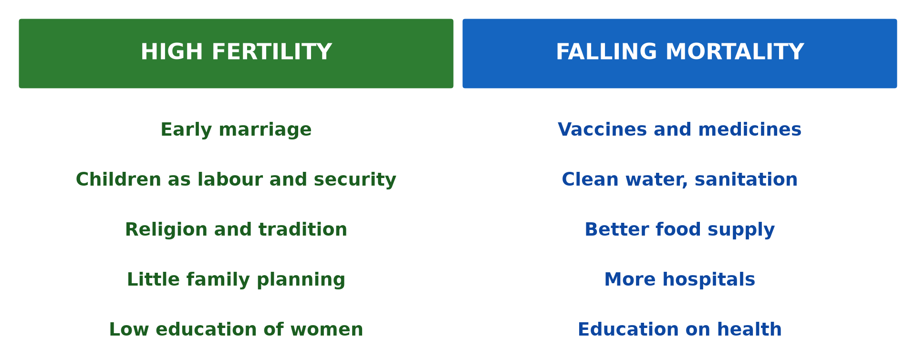
2. FERTILITY
Activity 3
Why births are high and deaths fall.
Notes:
Activity 3. Look carefully at this diagram: why births are high and deaths fall. Observe every detail before I ask the question.

Slide 27
2. FERTILITY
Activity 3: Question
Give two factors of high fertility in rural North Cameroon.
Notes:
Here is the question for Activity 3: Give two factors of high fertility in rural North Cameroon. Take one minute to think and write your answer in your rough notebook.

Slide 28
2. FERTILITY
Activity 3: Answer
Early marriage, the value of large families, need for farm labour, low female education (any two).
Notes:
Let us check the answer together. Early marriage, the value of large families, need for farm labour, low female education (any two).

Slide 29

2. MORTALITY
Activity 4
A vaccination campaign.
Notes:
Activity 4. Look carefully at this picture: a vaccination campaign. Observe every detail before I ask the question.

Slide 30
2. MORTALITY
Activity 4: Question
How do vaccines affect population growth?
Notes:
Here is the question for Activity 4: How do vaccines affect population growth? Take one minute to think and write your answer in your rough notebook.

Slide 31
2. MORTALITY
Activity 4: Answer
They lower the death rate, so the population grows faster.
Notes:
Let us check the answer together. They lower the death rate, so the population grows faster.

Slide 32
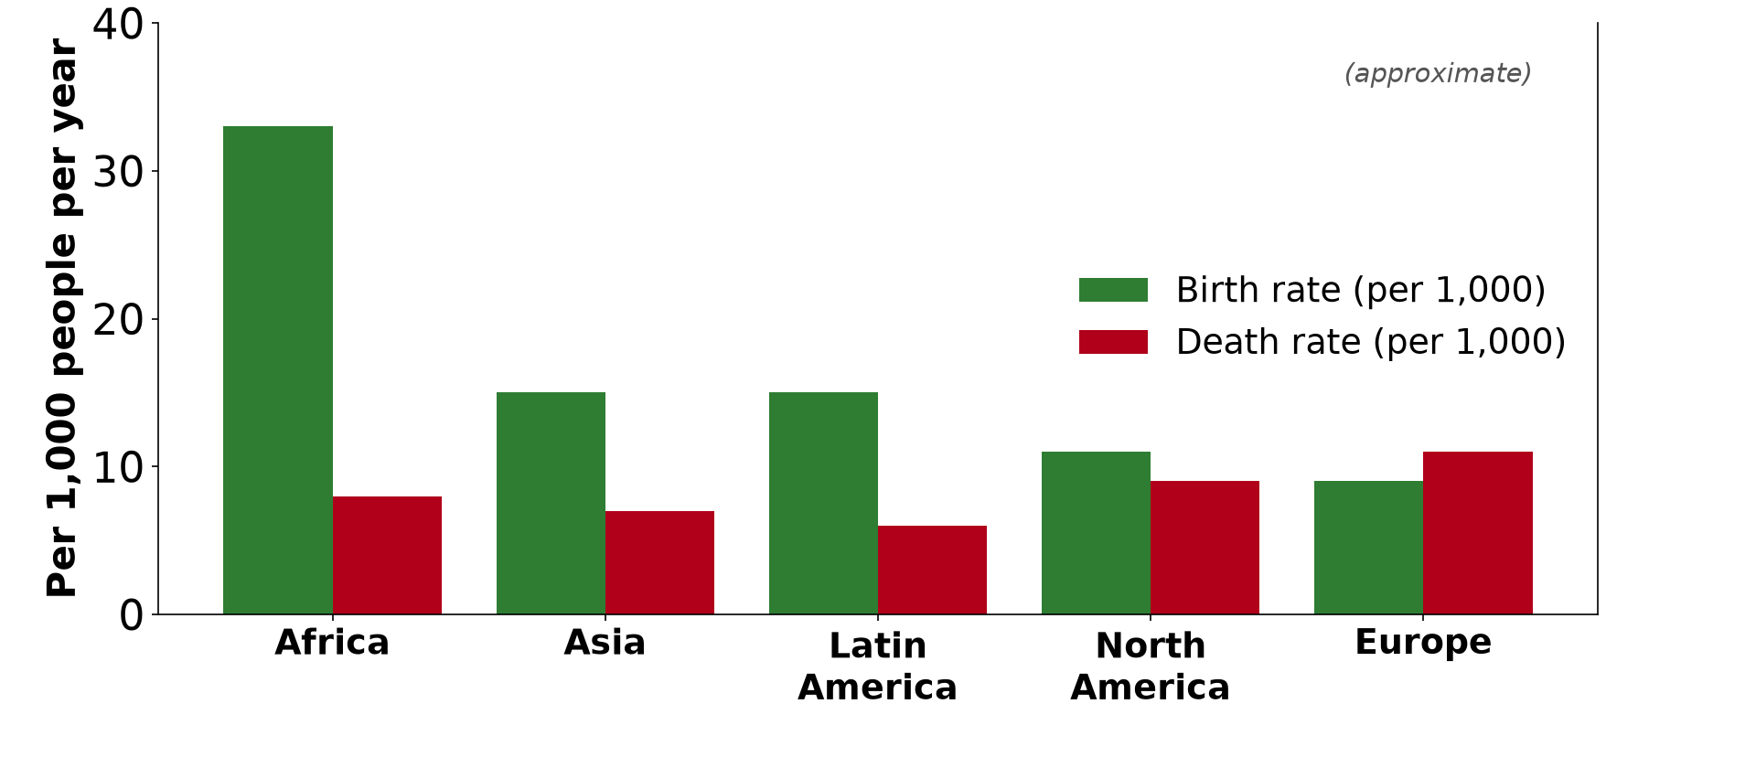
3. WORLD DIFFERENCES
Activity 5
Birth and death rates by continent.
Notes:
Activity 5. Look carefully at this diagram: birth and death rates by continent. Observe every detail before I ask the question.

Slide 33
3. WORLD DIFFERENCES
Activity 5: Question
Which continent has the biggest gap between births and deaths?
Notes:
Here is the question for Activity 5: Which continent has the biggest gap between births and deaths? Take one minute to think and write your answer in your rough notebook.

Slide 34
3. WORLD DIFFERENCES
Activity 5: Answer
Africa.
Notes:
Let us check the answer together. Africa.

Slide 35
BOARD SUMMARY
Board Summary
Topic: Population Change over Time (Population Growth)
Sub-topic: Population Growth
Lesson 9: Population Growth and its Determinants
Notes:
Now we are going to copy the board summary. Write the title and the headings neatly in your notebooks. I will give you enough time for each slide, so do not rush.

Slide 36
BOARD SUMMARY
DEFINITIONS
The key terms of this lesson are defined as follows:
Positive growth: It is an increase in population, when births and immigrants exceed deaths and emigrants.
Notes:
Let us copy the definitions. The key terms of this lesson are defined as follows. On this slide we have Positive growth. Write each point on a new line, with the key term first, and explain it in your own words when we revise. When you finish, we go to the next slide.

Slide 37
BOARD SUMMARY
DEFINITIONS (continued)
Negative growth: It is a decrease in population, when deaths and emigrants exceed births and immigrants.
Zero population growth: It is a stable population, when additions equal losses.
Natural increase: It is the excess of births over deaths.
Notes:
We continue with the definitions. On this slide we have Negative growth, Zero population growth and Natural increase. Write each point on a new line, with the key term first, and explain it in your own words when we revise. When you finish, we go to the next slide.

Slide 38
BOARD SUMMARY
DEFINITIONS (continued)
Net migration: It is the difference between the number of immigrants and the number of emigrants.
Notes:
We continue with the definitions. On this slide we have Net migration. Write each point on a new line, with the key term first, and explain it in your own words when we revise.

Slide 39
BOARD SUMMARY
1. Meaning of Population Growth
A) Types of Growth
Population growth is of the following types:
Positive growth: The population increases because births and immigrants are more numerous than deaths and emigrants. Cameroon, which grows by about 2.6 % a year, and Niger are examples.
Illustration: types of growth
Notes:
Let us copy Types of Growth. Population growth is of the following types. Copy the point on Positive growth on the left, then draw the diagram on the right: types of growth. Give it a title and label it clearly.

Slide 40
BOARD SUMMARY
1. Meaning of Population Growth
A) Types of Growth
Negative growth: The population decreases because deaths and emigrants are more numerous than births and immigrants. Japan and Italy are examples.
Notes:
We continue with Types of Growth. Copy the point on Negative growth: write the key term first, then its explanation.

Slide 41
BOARD SUMMARY
1. Meaning of Population Growth
A) Types of Growth
Zero growth: The population stays stable because additions equal losses. Some European countries, such as France, are close to zero growth.
Notes:
We continue with Types of Growth. Copy the point on Zero growth: write the key term first, then its explanation.

Slide 42
BOARD SUMMARY
1. Meaning of Population Growth
B) The Population Change System
The population change system works as follows:
The formula: Population change = (births − deaths) + (immigrants − emigrants). Births and immigrants are the inputs of the system, while deaths and emigrants are its outputs.
Illustration: the population change system
Notes:
Let us copy The Population Change System. The population change system works as follows. Copy the point on The formula on the left, then draw the diagram on the right: the population change system. Give it a title and label it clearly.

Slide 43
BOARD SUMMARY
1. Meaning of Population Growth
B) The Population Change System
Natural increase and decrease: Natural increase happens when the birth rate is higher than the death rate, as in Cameroon. Natural decrease happens when deaths exceed births, as in Japan.
Notes:
We continue with The Population Change System. Copy the point on Natural increase and decrease: write the key term first, then its explanation.

Slide 44
BOARD SUMMARY
1. Meaning of Population Growth
B) The Population Change System
Net migration: Net migration is the number of immigrants minus the number of emigrants. It is positive in Garoua and Douala, which receive many migrants, and negative in the villages they leave.
Notes:
We continue with The Population Change System. Copy the point on Net migration: write the key term first, then its explanation.

Slide 45
BOARD SUMMARY
2. Determinants of Population Growth
A) Fertility
Fertility, the main driver of population growth, depends on the following factors:
Meaning: Fertility is the frequency of live births in a population. It is the main determinant of population growth.
Notes:
Let us copy Fertility. Fertility, the main driver of population growth, depends on the following factors. Copy the point on Meaning: write the key term first, then its explanation.

Slide 46
BOARD SUMMARY
2. Determinants of Population Growth
A) Fertility
Factors of high fertility: Early marriage, the value given to large families, the need for farm labour and high infant mortality keep fertility high. In rural North Cameroon, where few girls go to school, many women have more than five children.
Illustration: the factors of growth
Notes:
Copy the point on Factors of high fertility on the left, then draw the diagram on the right: the factors of growth. Give it a title and label it clearly.

Slide 47
BOARD SUMMARY
2. Determinants of Population Growth
A) Fertility
Factors of low fertility: The high cost of raising children and the wide use of family planning reduce fertility. The education and careers of women and low infant mortality also reduce it.
Notes:
We continue with Fertility. Copy the point on Factors of low fertility: write the key term first, then its explanation.

Slide 48
BOARD SUMMARY
2. Determinants of Population Growth
B) Mortality and Migration
Mortality and migration depend on the following factors:
Factors of high mortality: Poor health care, poor sanitation and hygiene, malnutrition and famine keep death rates high. Disasters and wars also kill many people.
Notes:
Let us copy Mortality and Migration. Mortality and migration depend on the following factors. Copy the point on Factors of high mortality: write the key term first, then its explanation.

Slide 49
BOARD SUMMARY
2. Determinants of Population Growth
B) Mortality and Migration
Factors of low mortality: Vaccines, hospitals, clean water and good food reduce deaths. A high standard of living allows people to live longer.
Illustration: vaccination
Notes:
Copy the point on Factors of low mortality on the left, then draw the diagram on the right: vaccination. Give it a title and label it clearly.

Slide 50
BOARD SUMMARY
2. Determinants of Population Growth
B) Mortality and Migration
Factors of migration: Lack of jobs, poverty, drought and insecurity, such as the Boko Haram attacks in the Far North, push people out. Jobs, better schools and hospitals and security pull them to places such as Garoua and Douala.
Notes:
We continue with Mortality and Migration. Copy the point on Factors of migration: write the key term first, then its explanation.

Slide 51
BOARD SUMMARY
3. Spatial Differences on a World Scale
The determinants of growth differ across the world as follows:
Less developed countries: Most of Africa, including Cameroon, has high fertility and falling mortality. Natural increase is therefore high.
Illustration: birth and death rates
Notes:
Let us copy Spatial Differences on a World Scale. The determinants of growth differ across the world as follows. Copy the point on Less developed countries on the left, then draw the diagram on the right: birth and death rates. Give it a title and label it clearly.

Slide 52
BOARD SUMMARY
3. Spatial Differences on a World Scale
More developed countries: The USA, Germany and Japan have low fertility and low mortality. Their growth is slow, zero or negative.
Notes:
We continue with Spatial Differences on a World Scale. Copy the point on More developed countries: write the key term first, then its explanation.

Slide 53
BOARD SUMMARY
3. Spatial Differences on a World Scale
The role of migration: In developed countries, immigration is often the main source of population growth. In some poor countries, emigration reduces growth.
Notes:
We continue with Spatial Differences on a World Scale. Copy the point on The role of migration: write the key term first, then its explanation.

Slide 54
FORMATIVE EVALUATION
Evaluation 1
Distinguish between natural increase and net migration.
Notes:
Now let us check what you have understood. Question 1: Distinguish between natural increase and net migration. Answer in your exercise book.

Slide 55
FORMATIVE EVALUATION
Expected Answer
Natural increase is births minus deaths; net migration is immigrants minus emigrants.
Notes:
The expected answer is: natural increase is births minus deaths; net migration is immigrants minus emigrants. If you got it right, well done.

Slide 56
FORMATIVE EVALUATION
Evaluation 2
Give two factors of low mortality.
Notes:
Now let us check what you have understood. Question 2: Give two factors of low mortality. Answer in your exercise book.

Slide 57
FORMATIVE EVALUATION
Expected Answer
Vaccines and hospitals, clean water, good nutrition (any two).
Notes:
The expected answer is: vaccines and hospitals, clean water, good nutrition (any two). If you got it right, well done.

Slide 58
REMEDIATION
Remediation
Fill in the blanks:
When births exceed deaths, there is natural ______.
Immigrants − emigrants = net ______.
Japan has ______ growth.
Notes:
For those who need more practice, fill in the blanks in your exercise book. The answers are: number 1, increase; number 2, migration; number 3, negative.

Slide 59
HOMEWORK
Homework
Define the crude birth rate.
Notes:
For your homework: Define the crude birth rate. We shall correct it at the beginning of our next lesson.

Slide 60
NEXT LESSON
Next Lesson
Our next lesson will be on:
Practical Work 4: Calculating Demographic Indices
Notes:
Our next lesson will be on Practical Work 4: Calculating Demographic Indices. Thank you for your attention, and see you next time.

Slide 61
BILINGUAL GAME
Bilingual Game (Jeu Bilingue)
English | Français
Population growth | La croissance démographique
Fertility | La fécondité
Mortality | La mortalité
Natural increase | L'accroissement naturel
Net migration | Le solde migratoire
Infant mortality | La mortalité infantile
Notes:
Let us play the bilingual game. I say a word in English, and you give me the French word. Then we do the reverse.

Slide 62
LOGBOOK
Official Logbook (1/2)
Module / Topic | Population Change over Time (Population Growth)
Lesson Title | Lesson 9: Population Growth and its Determinants
Expected Learning Outcomes | Define positive, negative and zero growth. Explain the population change system and its formula. Explain the factors of fertility and mortality. Explain the role of migration. Compare growth in LEDCs and MEDCs.
Competence | Learners are able to explain how births, deaths and migration change the population of an area such as Garoua.
Notes:
I record this information in the official logbook of the class after the lesson.

Slide 63
LOGBOOK
Official Logbook (2/2)
Matter Taught | DEFINITIONS; Types of Growth; The Population Change System; Fertility; Mortality and Migration; Spatial Differences on a World Scale.
Evaluation | Formative evaluation and remediation exercise.
Homework | Define the crude birth rate.
Enrolment / Present / Absent | ____ / ____ / ____
Achievement | To be completed after the lesson.
Notes:
I complete the second page of the logbook: the matter taught, the evaluation, the homework and the attendance.

Slide 64
TEACHER'S NOTE
Teacher's Note
Timing: Homework correction, plan, objectives 8 min | Recall, situation, action 10 min | 5 activities 30 min | Board summary (copying) 30 min | Evaluation, remediation 10 min | Homework, next lesson 5 min | Logbook 7 min
Without the projector (Activity 1): draw the bars on the board.
Without the projector (Activity 2): build the formula with the class.
Without the projector (Activity 3): compare the family sizes of three generations.
Without the projector (Activity 4): list the vaccines given to babies.
Without the projector (Activity 5): write the rates on the board.
Notes:
This slide is for me, the teacher: it gives the timing of the lesson and what to do if the projector is not available.

Slide 65
REFERENCES
References
Geography Syllabus for Sixth Forms (Lower and Upper Sixth), MINESEC, 2019 — Module 4 (Population Geography).
Teacher's course notes: Mr KAMDEM E., Population Geography (USA), GBHS Garoua, 2026.
United Nations, World Population Prospects 2024.
Photo, Activity 4: “Isatu gets a vaccination for her 5 week old son” by World Bank Photo Collection, CC BY-NC-ND 2.0, via Flickr (https://www.flickr.com/photos/10816734@N03/26372818523)
Diagrams and animations: drawn for this lesson (Geography Department).
Notes:
These are the references and picture credits used to prepare this lesson.

